Slide 1

Civic Services Platform: Complaint Management System
Team 107
2026, Aug
IITM Online BS Degree Program,
Indian Institute of Technology, Madras, Chennai
Tamil Nadu, India, 600036

Slide 2
TEAM 107
TEAM INTRODUCTION
TEAM 107
Team Members | Student ID | Role
Ausha Murthy | 21f1006306 | Frontend
Paramveer Singh | 21f1006266 | Backend
Utkarsh Omre | 23f3000151 | Frontend
Someshwar Srimany | 21f1002093 | Backend
Shahzada Moon | 23f2002668 | Testing
Ritesh Kumar Jha | 23f3002470 | Backend

Slide 3
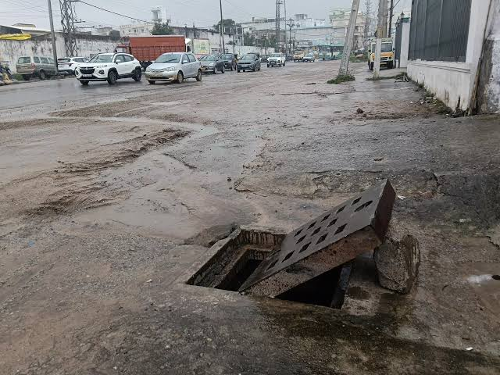
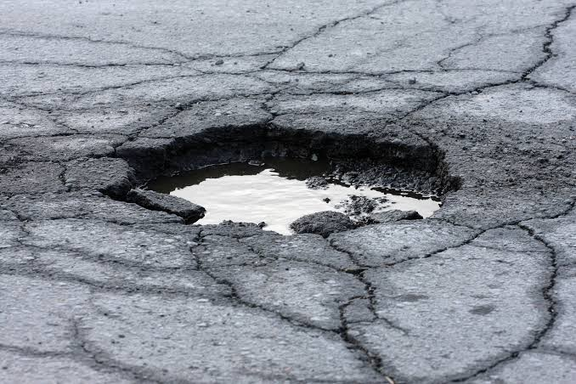
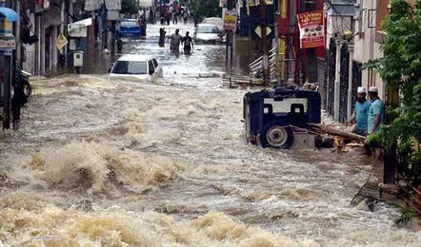
Municipal/civic grievance redressal — a real, common civic pain point
Today: complaints phoned in or filed on paper/ad-hoc portals, no tracking
Serves citizens, field officers, and municipal chairman/administration across wards
TEAM 107
THE PROBLEM STATEMENT

Slide 4
No visibility for citizens into complaint status after filing
No prioritization — officers work complaints in random order, not by severity/urgency
Duplicate complaints from multiple citizens for the same issue go untracked
No SLA enforcement — complaints sit open indefinitely with no escalation
No structured performance data on officers/wards for the chairman
Manual, disconnected communication between citizen ↔ officer ↔ administration
TEAM 107
PROBLEMS FACED

Slide 5
No visibility for citizens into complaint status after filing
No prioritization — officers work complaints in random order, not by severity/urgency
Duplicate complaints from multiple citizens for the same issue go untracked
No SLA enforcement — complaints sit open indefinitely with no escalation
No structured performance data on officers/wards for the chairman
Manual, disconnected communication between citizen ↔ officer ↔ administration
TEAM 107
OUR SOLUTION: CIVIC SERVICES PLATFORM

Slide 6
Citizen – Submit complaints, track status in plain language, view assigned officer, rate resolution
Field Officer – Priority queue (score-sorted), ticket detail, progress-note logging, resolution close-out
Municipal Chairman – City-wide overview, duplicate-cluster heatmap, officer performance & feedback analytics
TEAM 107
THREE USER ROLES

Slide 7
CITIZEN:
From interview to implementation
US-01 Submit a complaint with location, category, description, and images — officers act without needing to follow up.
US-02 Track status throughout the lifecycle without contacting anyone.
US-04 Rate the resolution, so a poor fix gets flagged instead of silently re-filed.
TEAM 107
USER STORIES

Slide 8
FIELD OFFICER:
Working the queue
US-06 See complaints ordered by priority, not submission order.
US-08 Have similar complaints already grouped into one ticket before it reaches the queue.
US-09 See how many citizens reported the same issue, to weigh urgency.
TEAM 107
USER STORIES

Slide 9
CHAIRMAN:
Seeing the whole city
US-10 View high-priority and delayed complaints in one place.
US-11 See duplicate complaint clusters to spot problem areas.
US-12 Review citizen feedback and officer performance together.
TEAM 107
USER STORIES

Slide 10
Score-Based Priority Queue – Officers see highest-impact tickets first, not FIFO
SLA Breach Monitor – Background job auto-flags overdue tickets and notifies every reporting citizen
Duplicate Complaint Merge – Multiple citizens reporting the same issue map to one ticket, all kept notified
Full Audit Trail – Every status change logged (TicketLog) for transparency
Role-Gated JWT Auth – Signup/login/refresh with per-role dashboards (Citizen/Officer/Chairman)
TEAM 107
KEY FEATURES & USP

Slide 11
Milestone 1
User Discovery & Requirements
Interviews with citizens and authorities; US-01–US-12 established.
Milestone 2
System Architecture & Design
Schema, wireframes, and component boundaries defined.
Sprint 1 · M3
Core API & Initial Development
Flask backend stood up: officer, chairman, and SLA-monitor endpoints.
Sprint 2 · M4
Advanced Features & Integration
Citizen complaint flow, frontend–backend integration, accessibility passes.
Milestone 5
Final Integration this deck
Test suite hardened to 36/36 backend, 32/32 frontend passing; full loop demo-ready.
TEAM 107
PROJECT PHASES

Slide 12
Real Speech-to-Text
Voice complaints are recorded as evidence today; a transcription provider turns that audio into searchable text.
Offline Replay Queue
The server already refuses duplicate submissions by client ID — next is local persistence so an offline submission survives and replays.
Real Zone Geometry
Replace coordinate-based zone resolution with an actual municipal boundary lookup.
TEAM 107
CONCLUSION & VISION

